Slide 1
Lecture 21b:
5.4. Africa
Brad DeLong
Department of Economics & Blum Center, U.C. Berkeley; & WCEG
last revised: Th 2020-04-09
for presentation: Th 2020-04-14
Original course by Melissa Dell (Harvard Econ 1342), revised by Brad DeLong
<https://github.com/braddelong/public-files/blob/master/econ-135-lecture-21b.pptx>
<https://www.icloud.com/keynote/0xRRhkj7cn2vsAXbYKCH4E9Ug>

Slide 2
Discussion
African Retardation:
What strikes you as important here?
Some questions on my mind (the first two about Africa; the next three for trying to pull together the general cross-continent post-WWII growth experience):
Is sub-Saharan Africa's trajectory a unique one, a “special way”, or has it just been an intensification of growth retarding features also seen substantially at work elsewhere?
How are we to understand the end of apparent African retardation around 2000?
Open till 1500 the middle east, especially what is now Turkey, Iran, and Egypt, seemed to have important and impressive civilizational advantages over western Europe. How old is the story of western Europe's growing post 1500 edge in prosperity look different if one looks not from the western European vantage point, as we did earlier in the course, but from the Middle Eastern?
Do you think what is going on in the interior of China, with the exception of a few cities along the Yangtze that look a lot like the coasts, is more like what has been going on in the rest of Asia or just the Pacific rim story delayed by a few decades?
Is your guess that China or India is more likely to be the world's predominant superpower come 2100

Slide 3
Africa
Tu Apr 14: 5.4. Africa:
Read Before: Nathan Nunn (2008): The Long Term Effects of Africa's Slave Trades <https://github.com/braddelong/public-files/blob/master/readings/article-nunn-long-term.pdf>
Slides: <https://github.com/braddelong/public-files/blob/master/econ-135-lecture-21b.pptx>
Discussion Thread: <https://bcourses.berkeley.edu/courses/1487685/discussion_topics/5747048>
Zoom Q&A Session: <https://github.com/braddelong/public-files/blob/master/econ-135-zoom-2020-04-14-10.02.09-92696375431-africa.zip>
30 minutes of audio

Slide 4
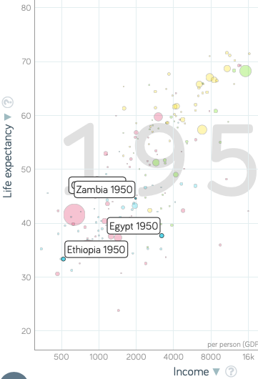
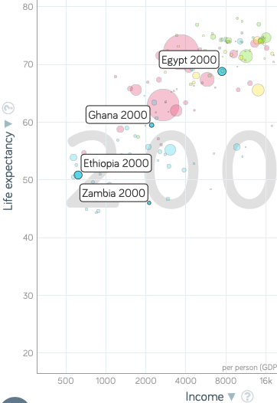
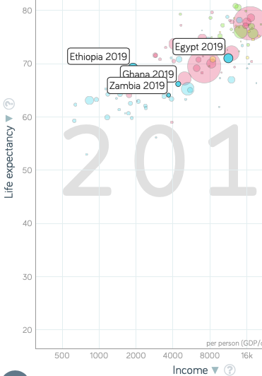

Africa Falls Behind, 1950-2000
The rest of the global south passes Africa between 1950 & 2000:
Most African countries have respectable—not global north but respectable—levels of prosperity in 1950
They do get richer from 1950-2000
But by 2000 their levels of prosperity are no longer respectable for the global south
With the exception of the Maghreb
After 2000 Africa gets into growth gear
But “African retardation” vis-a-vis south & east Asia & Latin America was not a thing in 1950
It is a creation of the post-WWII half century
1:30
Notes:
Today African retardation—that most sub-Saharan African countries are lagging well behind the rest of the global south in terms of levels of prosperity and income—is one of the most important and also one of the most puzzling facts about the modern economic growth process. But this retardation was not the case as recently as 1950. Back in 1950, African nations were "normal" for global south economies. They had levels of prosperity and income and productivity that were respectable—not global north levels but respectable—in 1950. And African economies do get richer, albeit at a slow and inadequate pace, from 1950 to 2000.
But by 2000 their levels of prosperity are no longer respectable for the global south. The rest of the global south went roaring on by most of the countries of Africa in that half century, in which African growth was distinctly inadequate by virtually everyone's anticipated or contemporaneous benchmarks. The exceptions are the economies of the Maghreb: the Mediterranean littoral economies north of and in the Sahara.
Thus any satisfactory explanation of African retardation must be rooted either (a) in things that have happened since 1950, or (b) account for why underlying structural causes of today's relative African poverty were masked in the world as it was back in 1950.

Slide 5
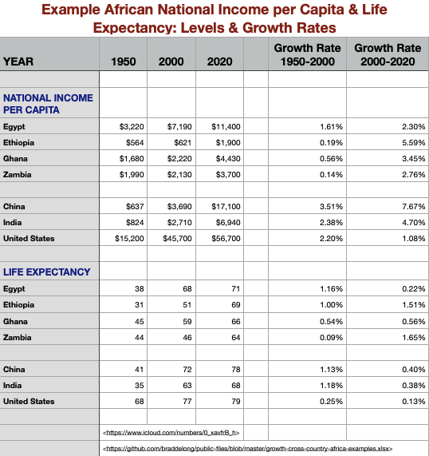
Africa Falls Behind, 1950-2000
Four example African countries:
Egypt (north, Maghreb), Ethiopia (east, poor), Ghana (west, well-integrated economically), & Zambia (south, industrializing)
Zambia, Ghana richer than Portugal in 1950
Egypt does not converge, but it grows along with the world from 1950-2000
The other three? Not
Substantial 1950-2000 improvements in life expectancy & other social indicators, however
What changes for good for Africa in 2000?
2:00
Notes:
To get a sense of the diversity of African experience since 1950, let us briefly look at four example African countries: Egypt, in the north, in the Maghreb; Ethiopia, in the east, and very poor; Ghana, in the west, and well integrated economically into the world economy; and Zambia, in the south, and industrializing at what seemed to be a sustainable and was a rapid pace back in 1950. Note that both Zambia and Ghana were richer than Portugal in 1950.
Since 1950, Egypt does not converge to anything like the global north norm. But Egypt grows along with the world from 1950 to 2000. The other three? No. There are substantial 1950 to 2000 improvements in life expectancy and other social indicators however. But in terms of levels of income per capita and of labor productivity, the African economies of Ethiopia, Ghana, and Zambia have an average growth rate of 0.3% per year. This is in a world and over a half century in which the United States grows at 2.2, India grows at 2.4, and China grows at 3.5% per year.
Then after 2000 sub-Saharan Africa picks up its mat and walks.
Ethiopian real income growth has averaged 5.6% per year since 2000: a doubling time of 12 years. Income per capita growth in Ghana is averaging 3.5% per year: Ghana is now twice as rich and prosperous as it was in 2000. Zambia has seen growth at 2.8% per year, fast enough to double income and productivity levels in a quarter century.
Admittedly, these numbers are still small beer relative to India's 4.7% per year or China's 7.7% per year, if we can indeed trust that last number. However, in a world in which the United States has only averaged 1.1% per year in income growth since 2000, the performance of Ethiopia, Ghana, and Zambia is heartening and even impressive.

Slide 6
African Institutional Development
Sub-Saharan Africa comes late to state-building:
Was the fact that state-building had to happen after 1950 a cause of slow growth?
Imperialism, its withdrawal, and African state capacity after WWII.
“Stateless” societies were still common in Africa until after WWII:
Somalia
The Nuer in South Sudan
The Tallensi in northern Ghana
The Hadza of Tanzania
The San in Botswana
Philip Curtin: In 1890 a quarter of Africans in “stateless” societies
Early 1400s: Kongo, Loango, Tio, Luba, Rund
Since 1000: Ghana, Mali, Songhay
Great Zimbabwe?
Nubia, Kush, Axum
Why might African political centralization have been delayed?:
Diamond: Lack of wheat, rice, corn agricultural staples for intensive agriculture—hence low population density
Adverse disease environment?
Vansina/McIntosh: unique sub-Saharan African sociological matrix inhibits centralization
3:15
Notes:
One theory of the causes of sub-Saharan African retardation from 1950 to 2000 is that the task of African countries over the generation after independence was state building. When the colonial powers withdrew, they removed their own institutions and elements of state capacity. Africa thus had to build the institutions and capacities of the state necessary to support a detailed division of labor and a modern trading network.
But building a state requires acting according to a logic of patronage, redistribution, and coalition assembly: a political logic. That powerfully interferes with economic growth in the short and medium run, necessary as a functional state is to attain and maintain modern industrial levels of prosperity in the long run.
Sub-Saharan Africa had come very late to state building. The inchoate institutions and practices present when the colonialists arrived were either insufficient after the colonialists withdrew or had been leveled in the process of empire. Hence nothing was left behind. And a very difficult task—one that had required half a millennium in western Europe—had to be accomplished in a generation.
Certainly it is the case that stateless societies were still common in Africa until after World War II. We look at Somalia, at the Nuer people in South Sudan, at the Tallensi in northern Ghana, the Hanza of Tanzania, or the San of Botswana. Historian and anthropologist Phillip Curtin has estimated that back in 1890 it was still the case that a quarter of Africans lived in “stateless” societies.
Peering back into the past, we see substantial state formation in the Congo basin in the 1400s: the Kongo, Loango, Tio, Luba, and Rund. We see the post-1000 inland empires of Ghana, Mali, and Songhay at the southern edge of the Sahara in west Africa—but how much of those were empires, and how much of those were armed trading networks across an extraordinary relative price gradient in the commodities of gold and salt, that appears more impressive because of gold’s place in other economies? We see Nubia, Kush, Axum, and Great Zimbabwe. But we do not see much else.
Why might African political centralization have been delayed? We have theories, but they are little more than just-so stories. Jared Diamond attributes it to: the lack of wheat, rice, and corn or equivalent agricultural staples to serve as the basis for intensive agriculture—hence low population density, and little social differentiation. Was it the adverse disease environment? We evolved in Africa, and thus there are lots of pests and parasites in Africa that live off of us and so sap our energy. Or was there something relatively unique in the sub-Saharan African sociological matrix that inhibited centralization and exploitation and domination at the level that agrarian age states needed to survive and flourish?

Slide 7
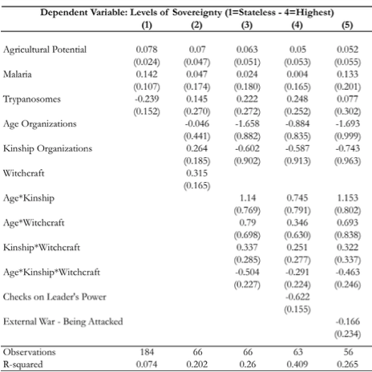
Within Sub-Saharan Africa Correlations
James Robinson: what determines a society’s “level of sovereignty” within Africa?:
Not correlated with agricultural potential
Not correlated with disease burden
Correlated with population density
Social network ties & belief structures?
Little robustness
(age) x (kinship) x (witchcraft)
Is sub-Saharan Africa in the agrarian age a success? Society successfully resisting the state?
1:30
Notes:
Comparisons between Africa and Eurasia are hopeless: too many variables, too few degrees of freedom. We can hope to look within Africa to figure out which of these theories appears to fit the within-Africa correlations. But we do not get very far.
Political scientist James Robinson tried to determine what correlates with a society’s “level of sovereignty” within Africa. And he found little. A more sophisticated pre-colonial state was not correlated with agricultural potential, was not correlated with disease burden, and while it was somewhat correlated with population density, population density is at least as far as if not further downstream in the causal waterfall network than state capacity.
How about if we look at the sociology—at patterns of social network ties and at belief structures? There is little robustness in the correlations. One could get excited—Jim Robinson and to a much lesser extent Melissa Dell do—at things like the fact that a combination of (a) strong age-based affinity networks, (b) strong kinship networks, and (c) witchcraft as an active force in the world are poisonous for state formation. But we would expect 5% of coefficients to be significant at the 0.05 level if there was no signal at all. And that is pretty much where we are.
And is susceptibility to state-building a good thing? Is sub-Saharan Africa in the agrarian age not a failure but a success? Did society’s successfully resisting the state provide sub-Saharan Africans with better lives for millennia than their dominated and oppressed agrarian-age counterparts in state-ridden Eurasia?

Slide 8
I Samuel 8:4 ff.
All the elders of Israel gathered themselves together, and came to Samuel unto Ramah:
And said unto him, “Behold, thou art old, and thy sons walk not in thy ways: now make us a king to judge us like all the nations.”…
And Samuel told all the words of the Lord unto the people that asked of him a king. And he said:
“This will be the manner of the king that shall reign over you: He will take your sons, and appoint them for himself, for his chariots, and to be his horsemen; and some shall run before his chariots. And he will appoint him captains over thousands, and captains over fifties; and will set them to ear his ground, and to reap his harvest, and to make his instruments of war, and instruments of his chariots. And he will take your daughters to be confectionaries, and to be cooks, and to be bakers.
“And he will take your fields, and your vineyards, and your oliveyards, even the best of them, and give them to his servants. And he will take the tenth of your seed, and of your vineyards, and give to his officers, and to his servants. And he will take your menservants, and your maidservants, and your goodliest young men, and your asses, and put them to his work.
“He will take the tenth of your sheep: and ye shall be his servants.
“And ye shall cry out in that day because of your king which ye shall have chosen you; and the Lord will not hear you in that day…”
2:00
Notes:
The Hebrew Bible’s book of 1 Samuel contains a discussion of the value of the state. It is not a favorable one.
Let me quote from the King James translation, even though it is not the easiest to understand. The language is beautiful. And since this is an ancient document speaking to us from the distant past, a translation that registers that is, I think, more true than one that tells us that these people could be alive with us today and thinking as we do:
>All the elders of Israel gathered themselves together, and came to Samuel unto Ramah. And they said unto him:
>>Behold, thou art old, and thy sons walk not in thy ways: now make us a king to judge us like all the nations.…
>And Samuel told all the words of the Lord unto the people that asked of him a king. And he said:
>>This will be the manner of the king that shall reign over you:
>>He will take your sons, and appoint them for himself, for his chariots, and to be his horsemen; and some shall run before his chariots. And he will appoint him captains over thousands, and captains over fifties; and will set them to ear his ground, and to reap his harvest, and to make his instruments of war, and instruments of his chariots.
>>And he will take your daughters to be confectionaries, and to be cooks, and to be bakers.
>>And he will take your fields, and your vineyards, and your oliveyards, even the best of them, and give them to his servants. And he will take the tenth of your seed, and of your vineyards, and give to his officers, and to his servants. And he will take your menservants, and your maidservants, and your goodliest young men, and your asses, and put them to his work.
>>He will take the tenth of your sheep: and ye shall be his servants.
>>And ye shall cry out in that day because of your king which ye shall have chosen you; and the Lord will not hear you in that day…

Slide 9
Slavery in Africa
Slavery & thralldom common in human history:
Steal people, rip them out of their social context, and sell them to foreigners
Then, without social ties or orientation, they can be treated worse than poor third cousins
Or things can get much nastier: galleys, mines, plantations
Genesis 37:23 ff.:
When Joseph was come unto his brethren, that they stript Joseph… and cast him into a pit…. And, behold, a company of Ishmeelites came from Gilead with their camels bearing spicery and balm and myrrh, going to carry it down to Egypt. And Judah said unto his brethren, “What profit is it if we slay our brother, and conceal his blood? Come, and let us sell him to the Ishmeelites, and let not our hand be upon him; for he is our brother and our flesh.” And his brethren were content…. They drew and lifted up Joseph out of the pit, and sold Joseph to the Ishmeelites for twenty pieces of silver: and they brought Joseph into Egypt…. And the Midianites sold him into Egypt unto Potiphar, an officer of Pharaoh's, and captain of the guard…”
3:00
Notes:
And then there is the theory that African retardation is a long-run consequence of centuries of slave raids on and against Africa—slave raids that destroyed the foundations and institutions of social trust at a very deep level, with lasting consequences for the ability of the societal matrix to support a prosperous economy. For this theory to work, the institutions, structures, practices, and values of colonial masters could serve to hold the economy together until the withdrawal of empires—and so Africa looked OK for the global south in 1950—but that the legacy of slavery began to tell after independence.
This is a very important theory. However, I am still not sure what I make of it.
It is a fact that slavery and thralldom have been depressingly common in human history. It has long been a thing to steal people, rip them out of their social context, and sell them to foreigners. Then, without social ties or orientation, they can be treated worse than poor third cousins—you can get a lot of work out of them, and they are much easier to control than those born and raised nearby, for such people have social network resources. And things can get much nastier than simply being treated like a poor low-status third cousin: people have been worked to death by the millions in the galleys, mines, plantations…
People are even anxious to engage in the slave trade: to sell their dependents and their relatives. Even their close relatives. Once again, from the Hebrew Bible. This time: Genesis 37:23 ff.:
>When Joseph was come unto his brethren, that they stript Joseph… and cast him into a pit…. And, behold, a company of Ishmeelites came from Gilead with their camels bearing spicery and balm and myrrh, going to carry it down to Egypt. And Judah said unto his brethren:
>>What profit is it if we slay our brother, and conceal his blood? Come, and let us sell him to the Ishmeelites, and let not our hand be upon him; for he is our brother and our flesh.
>And his brethren were content…. They drew and lifted up Joseph out of the pit, and sold Joseph to the Ishmeelites for twenty pieces of silver: and they brought Joseph into Egypt…. And the Midianites sold him into Egypt unto Potiphar, an officer of Pharaoh's, and captain of the guard…
Note that Judah here comes off much better than his other brothers who are the notional progenitors of the other tribes of Israel. That means the odds are very good that this passage was written by a member of the tribe of Judah—a Judean. The other brothers really do want to kill Joseph for being an annoying snot and, as one of the sons of Rachel, one of the favorites of their father the patriarch Jacob-Israel. Judah saves Joseph—and thus sets in motion the long causal chain that saves the people of Israel from starvation in the next famine.
Still, selling your brother into slavery for twenty pieces of silver is not a good look.

Slide 10
Slavery in Africa II
Slave trades in the past millennium:
“Black Sea”
“Barbary Coast”
Indian Ocean
Atlantic-Caribbean
Two moments at which slavery rapidly intensified:
Coming of the slavery-driven “Atlantic economy” after 1600
Abolition of the slave trade, followed by redeployment of slaves into African plantations to grow export agricultural crops
30% of western Sudanese slaves in 1900? Slavery “abolished” in Sierra Leone in 1928, in Nigeria in 1936, in Mauritania in 1981
Slave trades: Atlantic1600-1850: 13M? Indian Ocean 1000-1900: 5M? Internal African 1500-1900: 5M? Trans-Saharan 1200-1900: 3M? Barbary Coast 1500-1800: 1.5M? Black Sea 1400-1750: 3M?
Population of Africa in 1700: 60M?
People born in Africa & surviving to age 5, 1500-1800: 360M?
2:30
Notes:
The trans-Atlantic European-run guns-slaves-sugar slave trade that ripped the heart out of Africa from 1600 to 1850 is only one of the major slave trades in the past millennium of human history. Ther are in addition the “Black Sea”, “Barbary Coast”, Indian Ocean, and internal African slave trades.
There appear to be two eras in the past at which the effects and scale of African slavery rapidly intensified: The first is the coming of the slavery-driven “Atlantic economy” after 1600. The second is, somewhat paradoxically, the era of the abolition of the Atlantic slave trade. It was followed by redeployment of slaves into African plantations to grow export agricultural crops. And the profits from selling plantation-grown crops turned out to be greater than those of selling people overseas.
The scale of this? We really do not know. Was it really the case that 30% of western Sudanese wer slaves in 1900? How long did this last? Supposedly, slavery was “abolished” in Sierra Leone in 1928, in Nigeria in 1936, in Mauritania in 1981.
If you want numbers—and we do—here are our best guesses as to the size of the slave trades: Atlantic 1600-1850: 13M? Indian Ocean 1000-1900: 5M? Internal African 1500-1900: 5M? Trans-Saharan 1200-1900: 3M? Barbary Coast 1500-1800: 1.5M? Black Sea 1400-1750: 3M?
Compare these to a population of Africa in 1700 of perhaps 60 million, and to perhaps 360 million people born in Africa & surviving to age 5 over the years 1500-1800.

Slide 11
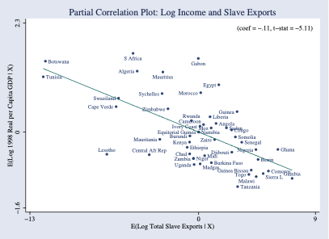
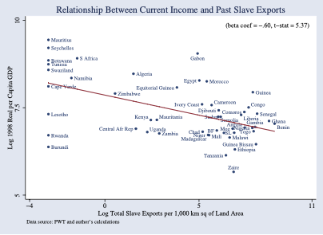
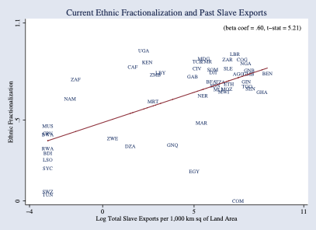
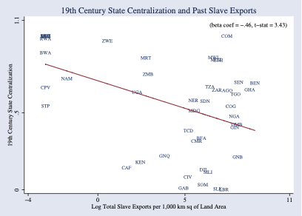
Consequences
Societal disintegration:
Nathan Nunn has constructed estimates:
The negative effects of the slave trade on income per-capita in Africa.
Shipping records, plantation records, sales receipts, the ethnicity/origin of slaves
Intensity of slaving negatively correlated with income today
Intensity of slaving negatively correlated with institutional quality.
A fall of one standard deviation in the extent of slaving raises income per capita by 50%
0:30
Notes:
The consequences in terms of societal disintegration and thus the creation of the deep roots of African retardation may have been very large indeed. Nathan Nunn has crunched the numbers on the correlation of slave raiding with economic retardation within Africa, and has found that the intensity of slave raiding is strongly negatively associated with institutional quality and economic prosperity today: where the intensity of slave raiding is lower by one standard deviation, income per capita is higher by 50%.

Slide 12
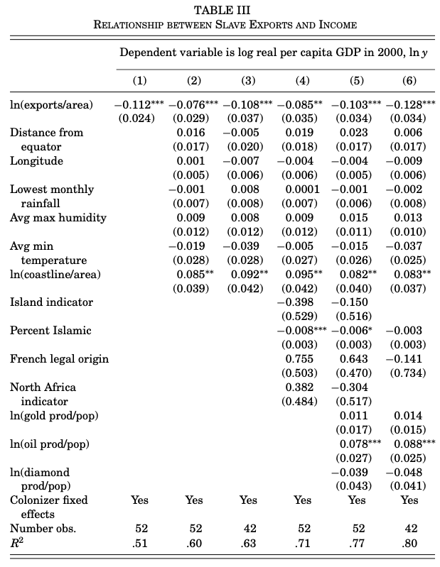
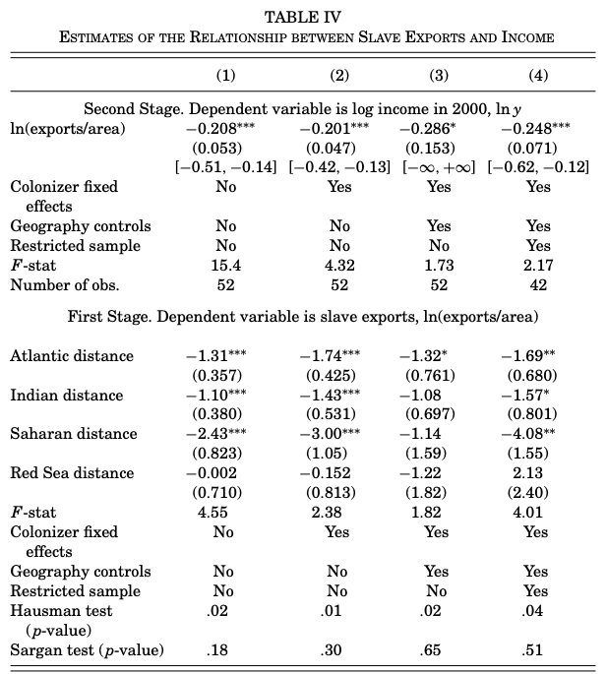
Regression Results
1:45
Notes:
Is this association an accident? Is it that one set of factors made slave raiding intensive, and another set of factors make countries today poor, and that these both just happen to be operating in largely the same places within Africa? Or is it that factors that make today’s African economies poor were, in the past, also operating to make them vulnerable to slave raids?
I think that this is, more likely than not, most of what is going on.
Nathan Nunn disagrees. Nunn points out that proximity to slave markets is a powerful piece of susceptibility to slave raiding. And that it looks like that component of slave raiding which is produced by proximity to slave markets alone is even more powerfully associated with economic retardation today. In fact, his coefficient estimates are that the true effect of a one standard deviation increase in slave raiding is to reduce prosperity by two-thirds—although the estimate is imprecise: it could be one-third, it could be five-sixths.
This seems to me to be alarmingly large: that countries susceptible to slave raiding because of geographical proximity to slave markets had other advantages that should have benefited their economies today by twice as much as the slavery-poverty correlation, but that these advantages are masked by a true underlying causal effect of slave raiding on poverty three times as large as the correlation we see—I find that too big to swallow. And so I find myself unable to believe in Nunn’s identifying assumption: that geography affects prosperity in Africa today only through the fact that economies closer to slave markets were more vulnerable to slave raiding.
Hence I conclude: suggestive, and important to assess, but that we really do not yet know.

Slide 13
Why Trade Slaves?
Astonishingly “Inefficient”:
20% of captives died en route between Africa and the Americas.
Far more died in the violence of capture or on the way to be sold
(Joseph Miller estimated that 50% of the slaves caught in the interior of Angola died before being sold at the coast
Low African population density
Slavery worthwhile by elites to avoid paying high wages
But that means slaves would have been very productive kept in Africa
(Slave exports from Bali, and the 1815 Mt. Tambora explosion)
Lack of centralized states meant maintaining domination not easy
Sell slaves to Europeans, & maintaining domination then becomes their problem
1:30
Notes:
And then there is the underlying question: why would a society—even a dysfunctional society—trade away its people to other continents for money? For one thing, intercontinental slaving is astonishingly “inefficient”. 20% of captives died en route between Africa and the Americas. Far more died in the violence of capture, or on the way to be sold. (Joseph Miller estimated that 50% of the slaves caught in the interior of Angola died before being sold at the coast.) You can argue that low African population density made it worthwhile for elites to resort to slavery and domination to avoid paying the high market wages that would have been generated by a wage-labor system in the context of a high land-labor ratio. But that high land-labor ratio means that slaves would have been very productive kept in Africa
Melissa Dell notes the consequences of the 1815 Mt. Tambora explosion for the island of Bali. The soil of Bali, enriched by volcanic ash, became much more productive. And in the explosion’s aftermath slave exports from Bali ceased: more profitable to enslave people, but then keep them at home and set them to work farming the newly enriched volcanic soils.
Was it that the lack of centralized states meant maintaining domination was not easy? That you could sell slaves to Europeans and Middle Easterners, and that maintaining domination then becomes their problem? Perhaps.

Slide 14
Did European Colonialism Underdevelop Africa?
Cheerleaders for colonialism:
What Dell calls the “eccentric consensus”: colonial officials and academics such as Peter Bauer and Niall Ferguson agree with Marxists like Lenin and Bill Warren’s Imperialism: Pioneer of Capitalism that colonialism stimulated economic growth in Africa:
Modern institutions and organizational forms…
Technologies such as railways and mines…
Integration into increasingly globalized world economy
Research into curing “tropical” diseases…
But: resource expropriation
Melissa Dell’s calculation of the effects of the Natives Land Act of 1913 in South Africa
Expropriating 93% of the land
For a wage share of 2/3, generates a 59% decline in African living standards
To some degree elite replacement, but still…
2:00
Notes:
Let us move forward in time to the colonial era, and ask: did European colonialism underdevelop Africa? I think that it is overwhelmingly likely that the answer to that question is yes.
Now there are cheerleaders for colonialism—what Melissa Dell calls the "eccentric consensus". Colonial officials, plus academics like Peter Bauer and Niall Ferguson, agree with Marxist politicians like Vladimir Lenin and intellectuals like Bill Warren (in his book Imperialism: Pioneer of Capitalism) that colonialism actually stimulated economic growth and long-run prosperity in Africa.
Colonialism brought modern institutions and organizational forms. It brought technologies such as railways and mines. It brought integration into the increasingly globalized world economy. It brought research into curing “tropical” diseases.
But all this pales, in my view, in the shadow of resource expropriation. Colonialism was not an eleemosynary activity. Melissa Dell has calculation of the effects of the Natives Land Act of 1913 in South Africa. Expropriating 93% of the land, assuming a wage share of 2/3, generates a 59% decline in African living standards. To some degree this has smaller effects on the typical African—it can be viewed, to some degree, as elite replacement. But the cheerleaders for colonialism seem, to me at least, to have to fail to do the most basic math, and to have to willingly and knowingly close their eyes to a lot.
It is true, as W. Arthur Lewis said, that the colonial experience was sufficiently divergent that you can find an example on the ground proving any conceivable theoretical argument about colonialism’s nature. But let us not pretend that it was typically undertaken for the benefit of the “natives”. Rudyard Kipling could write poems about how it was in order to sell into the market of those Europeans who wanted their consciences salved. But don’t take it as anything more than that.

Slide 15
Balance of the Evidence
Pre-colonial polities, European settlement, all other:
Pre-colonial polities: colonialism stopped the existing dynamics of centralization, severed links of accountability (indirect rule) and in many cases created/intensified conflict
Large-scale European settlement: mass immizerization associated with land expropriation, creation of huge inequalities, institutionalized racism
Others: European contact brings much greater social connectivity and economic integration
But was colonialism the best way to do that?
Johannes Fedderke & al.: colonialism does not bring higher-quality property rights
1:00
Notes:
The balance of the evidence is, rather, strongly against the position of colonialism’s cheerleaders. In places in Africe that had or were developing polities in the pre-colonial era, colonialism stopped the existing dynamics of centralization, severed links of accountability via indirect rule, and in many cases created or intensified ethnic conflict and social division. In places in Africa like South Africa or the Kenyan highlands that became areas of large-scale European settlement, we saw mass immizerization associated with land expropriation, creation of huge inequalities, iand nstitutionalized racism. Elsewhere, the coming of the Europeans and of high-bandwidth contact via trade and ideas did bring much greater social connectivity and economic integration. But merchants and traders and missionaries and educators are not proconsols. Conquest and colonialism is not the best way to do that. And there is no evidence that colonialism brought higher-quality property rights and their benefits to the colonized: rather the reverse, as all property because potential spoils for colonizers.

Slide 16
Colonialism: Ghana
The Asante as a “martial race”:
Asante chiefs were made into the tools of indirect rule.
Post-independence politics dominated by Nkrumah and an anti-Asante coalition initiating a cycle of anti-Asante and pro-Asante regimes. Today the two main political parties revolve around this cleavage.
The fight for power after 1957 led to political instability, coups, military rule, the expropriation of the cocoa farmers. The nature and structure of this conflict was entirely a legacy of the colonial state.
A plausible counter-factual is that Asante would have expanded and formed a “nation state”. This might not have been developmental, but it would have avoided indirect rule and the political instability which undermined the economy.
Economic growth during the colonial period was a purely African development which would plausibly have occurred without British intervention (Hill, 1963, Austin, 2005).
The allocation and regulation of land were made less efficient by indirect rule (Colson, 1971, Goldstein and Udry, 2008).
Location of infrastructure was determined by the desire to rule as much as develop and the only reason that Asante had not previously built a railway to the coast was because the British colonial office had blocked it (Chaves, Engerman and Robinson, 2012).
Missionaries were the driving force behind educational expansion in British colonies and a reasonable counterfactual is that absent colonization the missionaries would have come anyway.
3:00
Notes:
Melissa Dell in her version of this course focuses closely on two examples of colonialism in Africa: Ghana and Sierra Leone.
Let’s look at them less intensively. Let’s look first of colonialism in Ghana.
The British thought that the Asante of Ghana were a “martial race”: one that had done more than most to resist their conquers, and fit to be intermediaries. So the Asante chiefs were made into the tools of “indirect rule”: the British provided them with weapons and logistical support and backup, if the Asante chiefs kept things running. Moreover, the British were more interested in building infrastructure into Asante regions than elsewhere.
Melissa Dell believes that a plausible counterfactual for Ghana in the 1800s, had the British not conquered it, would have been the formation of an Asante “nation-state”, along the lines of what we saw in Europe: the core region assimilates the others into its dominant ethnicity—just as Gascons and Bretons remained Gascons and Bretons but also became Frenchmen. Such a Ghanian nation-state might not have been a “developmental state”. But ethnic cleavages today would be less. The patterns of indirect rule would not have left their mark. And perhaps Ghana would have had less political instability since 1950—political instability which undermined the economy. Certainly the nature and structure of post-indepenence ethnicly-driven political conflict was entirely a legacy of the colonial state.
Post-independence, Ghanian politics was dominated by the explicitly anti-Asante Kwame Nkrumah and his anti-Asante coalition. That initiated a cycle of anti-Asante and pro-Asante regimes which has lasted to this day. The two main political parties today revolve around this cleavage—are the Asante to be taken down a peg and is their wealth to be taken and rediverted? Or are the Asante to be boosted?
But, Peter Bauer and Niall Ferguson and Vladimir Lenin and Bill Warren would say, British imperial rule brought the railroad! British imperial rule brought access to the markets for Ghanian cocoa and oil!!
I think not.
According to Meilissa Bell, economic growth during the colonial period was a purely African development, which would plausibly have occurred without British intervention (Hill, 1963, Austin, 2005). The allocation and regulation of land were made less efficient by indirect rule (Colson, 1971, Goldstein and Udry, 2008). Location of infrastructure was determined by the desire to rule, as much as develop. The only reason that Asante had not previously built a railway to the coast was because the British colonial office had blocked it (Chaves, Engerman and Robinson, 2012).
But education? Surely the British empire brought education? Missionaries brought education. Missionaries were the driving force behind educational expansion in British colonies. A reasonable counterfactual is that, absent colonization, the missionaries would have come anyway.
You can work, trade, learn, and teach from people without having to conquer and rule them.

Slide 17
Institutions: Sierra Leone
In 1787 Freetown founded
Home for London’s ‘Black poor’ and repatriated slaves
After 1807 Freetown was an important base for the British anti-slave trade squadron
No large centralized state like the Asante Empire
In the second half of the 19th century the interior was expropriated by the British via a sequence of treaties with individual chiefs
Frederick Cooper proposed the notion of the ‘Gatekeeper State’ in Africa - colonial powers sat on the coast and developed the minimal amount of infrastructure necessary to keep order and extract natural resources: Sierra Leone looks like a good example for him:
Indirect rule and Paramount Chiefs
The British often interfered with the legitimacy of the traditional powerholders.
Instead of their authority coming from the people, the authority of chiefs now came from the colonial state
Severed linkages between the chiefs and their people
Extraction of taxes and unpaid labor on the farms of chiefs increased as a result
1:15
Notes:
Let’s look next at colonialism in Sierra Leone. There was no large centralize state like the Asente empire to be conquered, and to impress the British conquerors with the resistance. The interior was expropriated by the British from 1850 on via a series of treaties with individual chiefs. Frederick Cooper has proposed that Sierra Leone is an excellent example of his "gatekeeper state": the colonial power sits on the coast and develops the minimal amount of infrastructure necessary to extract natural resources, and keep order.
The British Empire ruled indirectly via “Paramount Chiefs”. The British would place a Paramount Chief in control if he would do their will. Paramount Chiefs ceased to gain their legitimacy from the consent of the community and instead gained it via British imposition. Thus the negotiations that keep rulers from being simply plunderers—that require them to do their jobs rather than simply exctract resources—ceased to take place.
The extraction of taxes and unpaid labor on the farms of chiefs increased as a result. And the parasitic predatory pattern of rule would be generalized after independence.

Slide 18
After Independence: Sierra Leone
In 1961 British handed power to Sir Milton Margai and his Sierra Leone People’s Party (SLPP):
Support primarily in the South (Mendeland) and East
In 1967 the SLPP narrowly lost a hotly contested election to Siaka Stevens’ All Peoples Congress party (APC).
Anti-Stevens military coup led by Mende officers (who dominated the higher ranks of the military)
Pro-Stevens counter-coup led by northern junior officers
Siaka Stevens: President of Sierra Leone 1967-1985
Favorite Aphorism—“The cow eats where it’s tethered”
Pull up the railroad to isolate and undermine the economy of the East and the rural support for the SLPP.
But this also crippled the coffee farmers
One-party state
Patrimonial and violent: Sam Bangura—Governor of the Central Bank—was thrown off the roof
The economy and state collapsed
Paramount Chiefs as local despots:
Must come from ruling families
More ruling families, more potential political competition
Moving from 1 ruling family to the mean of 4:
increases literacy by one standard deviation, or 6 percentage points
increases non-agricultural employment by 1 percentage point, from a base of only 3 percent
1:20
Notes:
In 1961 British handed power to Sir Milton Margai and his Sierra Leone People’s Party (SLPP), which drew its support primarily from Sierra Leone’s east and its south—the area called Mendeland, where the dominant ethnic group was the Mende. In 1967 the SLPP narrowly lost a hotly contested election to Siaka Stevens’s All Peoples Congress party (APC). And the higher ranks of the military—dominated by officers from the Mende—objected. The army leaders then staged an anti-Stevens military coup.
But the high command did not control the army. They were in turn overthrown by a pro-Stevens counter-coup led by northern junior officers. And Siaka Stevens became President of Sierra Leone from 1967 to 1985, ruling a one-party state in a vicious, violent, and patrimonial way. It is not often that the Governor of your central bank finds himself being thrown off a roof by the president’s thugs.
Stevens set out to make his opponents—or at least their supporters—poor. Demonstrate that the only way to get resources was fealty to Stevens. Thus he would dismantle the patronage network of his opponents. And any of their supporters who remained engaged would be too poor to cause any trouble.
And lower down subordinate local powerbrokers imitated him: the more local Paramount Chiefs could insulate their rule from challenges, the more resources they extracted.

Slide 19
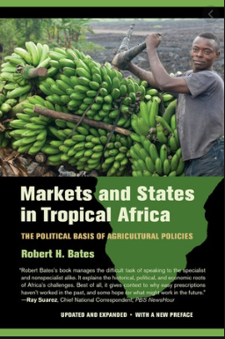
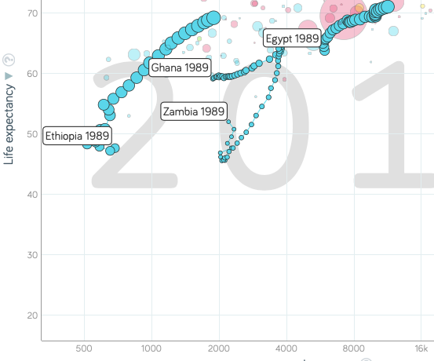
Markets and States in Tropical Africa
Robert Bates’s classical statement of the problem:
Written long before predatory post-colonial African states had reached their peak
But do not think that slave-raiding and colonial heritage patterns have doomed Africa
Since 2000, African growth has gotten itself in gear
Prosperity doubling times for Ethiopia, Ghana, and Zambia of 12, 20, and 26 years respectively—impressive…
1:00
Notes:
The classic statement of the poisonous political economy of the corrupt, predatory, and patrimonial states of postcolonial Africa was Robert Bates's book: Markets and States in Tropical Africa. It was written long before this predatory post-colonial political-economic configuration had reached its peak.
But do not think that the slave-raidng and colonial-rule patterns that underlay the development of this political economy have come to doom Africa.
Since 2000, African growth has gotten itself in gear. Prosperity has advanced pretty much all across the continent. Since 2000, the doubling times for Ethiopian, Ghanaian, and Zambian productivity levels have been 12, 20, and 26 years respectively. That is impressive, especially considering what had come before.

Slide 20
Big Ideas: Lecture 21b: African Retardation
Takeaways from this class:

Slide 21
Roadmap for the Next Two Weeks…
21. Th Apr 16: 5.5. South Asia & Middle East
Read Before: Sevkut Pamuk (2014): Institutional Change and Economic Development in the Middle East, 700-1800 <https://delong.typepad.com/files/pamuk.pdf>
Slides: <https://github.com/braddelong/public-files/blob/master/econ-135-lecture-21.pptx>
6. Policy Issues
22. Tu Apr 21: 6.1. "Deep Roots" vs. Path Dependence
Read Before: Nathan Nunn (2012): Culture and the Historical Process <https://delong.typepad.com/files/nunn-culture.pdf>
Read Before: Melissa Dell (2015): Path Dependence in Development: Evidence from the Mexican Revolution <https://scholar.harvard.edu/files/dell/files/revolutiondraft.pdf>
Slides: <https://github.com/braddelong/public-files/blob/master/econ-135-lecture-22.pptx>
23. Th Apr 23: 6.2. Growth and Fluctuations; Trade and Development, Foreign Aid
Read Before: Barry Eichengreen (2015): Hall of Mirrors: The Great Depression, The Great Recession, and the Uses-and Misuses-of History, selections <https://delong.typepad.com/files/eichengreen-mirrors.pdf>
Read Before: David Atkin (2014): Endogenous Skill Acquisition and Export Manufacturing in Mexico <https://delong.typepad.com/files/atkin-skill.pdf>
Slides: <https://github.com/braddelong/public-files/blob/master/econ-135-lecture-23.pptx>
24. Tu Apr 28: 6.3. Populism, Plutocracy, Kleptocracy, & Neo-Fascism
Read Before: Ernest Gellner (1973): Nations & Nationalism, selections <https://delong.typepad.com/files/gellner-nations.pdf>
Read Before: Barry Eichengreen (2018): The Populist Temptation Economic Grievance & Political Reaction in the Modern Era, selections <https://delong.typepad.com/files/eichengeeen-populist.pdf >
25. Th Apr 30: 6.4. Global Warming
Read Before: Melissa Dell et al. (2012): Temperature Shocks & Economic Growth: Evidence from the Last Half Century <https://scholar.harvard.edu/files/dell/files/aej_temperature.pdf>
Read Before: Melissa Dell et al. (2014). What Do We Learn from the Weather? The New Climate-Economy Literature, selections <https://economics.mit.edu/files/9138>

Slide 22
Roadmap Following…
Tu May 5: 6.5. The Pace and Meaning of Economic Growth
Read Before: William Nordhaus: Do Real-Output and Real-Wage Measures Capture Reality? <https://www.nber.org/chapters/c6064.pdf>
Read Before: John Maynard Keynes: Economic Possibilities for Our Grandchildren<<https://delong.typepad.com/files/keynes-persuasion.pdf>
Read Before: Edward Bellamy (1887): Looking Backward 2000-1887, selections <https://delong.typepad.com/files/bellamy-backward.pdf>
7. Conclusion
Th May 7: 7. Conclusion: The Future?
Read After: Robert Allen (2011): Global Economic History: A Very Short Introduction, selections <https://delong.typepad.com/files/allen-geh.pdf >
W May 13 11:30-14:30: FINAL PAPER/PROJECT DUE

Slide 23
Catch Our Breath…
Ask a couple of questions?
Make a couple of comments?
Any more readings to recommend?

Slide 24
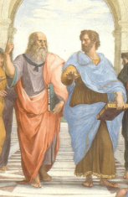
Notes, etc.…

Slide 25

Coronavirus!

Slide 26
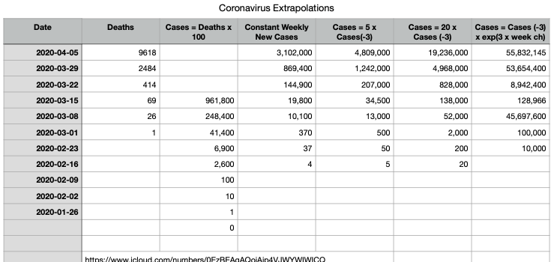
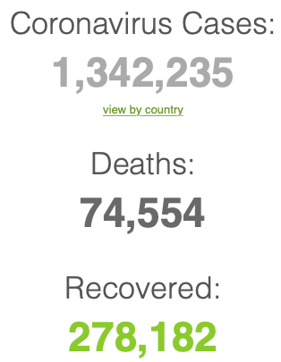
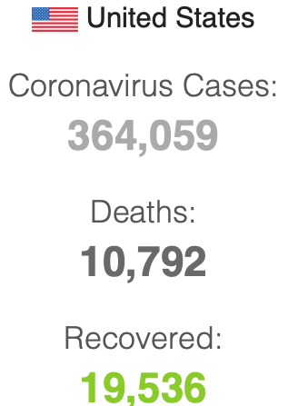

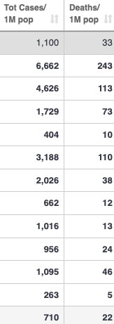
Coronavirus
Where we think we are, as of Th Apr 09:
We really do not know
No random samples…
If we extrapolate out the past week straight-line log:
We will have 440,000 deaths in three weeks
But it is unlikely to be that bad
Best thing I have read comes from Jim Stock <https://drive.google.com/file/d/12MV466ZZy5xHir4xdPhoTrL1oO8CbZU-/view>:
The basic SIR epidemiological model of contagion
The effect of social distancing and business shutdowns on epidemic dynamics enters the model through a single parameter: the case transmission rate β
Re-express the model in terms of β and the asymptomatic (or not very symptomatic) hence non-tested rate—the fraction of the infected who are not tested
The COVID-19 non-testing rate is unidentified in our model
Estimates in the epidemiological literature range from 0.18 to 0.86.
The asymptomatic rate could be estimated accurately and quickly by testing a random sample
The optimal policy response and its economic consequences hinge critically on the asymptomatic rate

Slide 27
Coronavirus II
We do not really know where we are, as of Mo Apr 6:
Best thing I have read comes from Jim Stock <https://drive.google.com/file/d/12MV466ZZy5xHir4xdPhoTrL1oO8CbZU-/view>:
The basic SIR epidemiological model of contagion
The effect of social distancing and business shutdowns on epidemic dynamics enters the model through a single parameter: the case transmission rate β
Re-express the model in terms of β and the asymptomatic (or not very symptomatic) hence non-tested rate—the fraction of the infected who are not tested
The COVID-19 non-testing rate is unidentified in our model
Estimates in the epidemiological literature range from 0.18 to 0.86.
The asymptomatic rate could be estimated accurately and quickly by testing a random sample
The optimal policy response and its economic consequences hinge critically on the asymptomatic rate

Slide 31

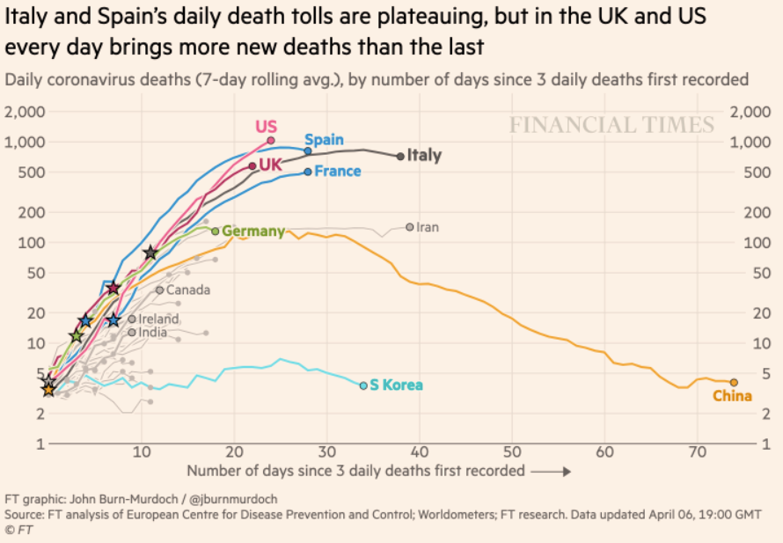
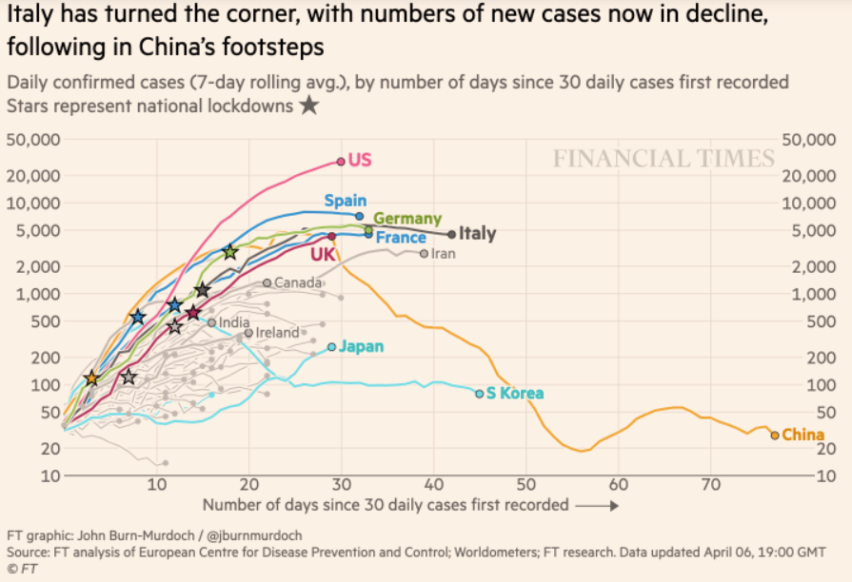
Financial Times Graphs Blown Up…

Slide 35
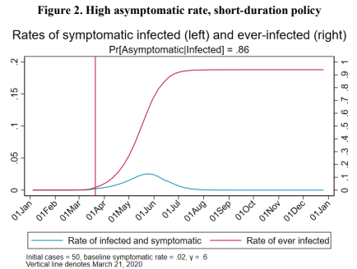
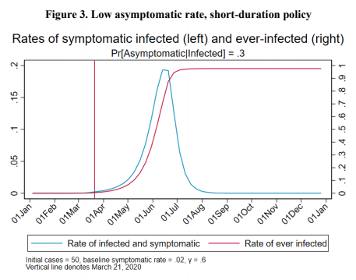
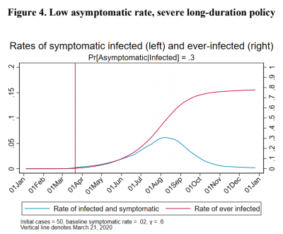
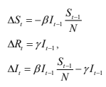
James Stock (2020)
Standard SIR model:<https://drive.google.com/file/d/12MV466ZZy5xHir4xdPhoTrL1oO8CbZU-/view>:
Susceptible, Infected, Recovered (& immune), transmission rate β, recovery rate γ, reproduction number R0, asymptomatic hence non-tested rate π0
Calibration: half-life of infection one week: γ = 0.5, s0 = 0.02, 50 cases on Jan 24
For March 21, 2020, the positive test rate in the United States is approximately 10%…
<https://drive.google.com/file/d/12MV466ZZy5xHir4xdPhoTrL1oO8CbZU-/view>

Slide 40
Bringing the Economy Back Up from Anæsthesia
Major issues:
Certificates of immunity:
Which requires test, test, test:
And not just disease virus tests
Presence-of-antibodies tests
How quickly can we match the immune with public-contact jobs?
What jobs can be done with minimal infection risk?
What minimal-infection substitutes can we find for previous jobs?
How quickly can restrictions be relaxed without the virus coming roaring back?
How do we avoid having the market give a “shutdown” signal to enterprises we in fact want restarted?
Which is pretty much all of them
How much of the potential caseload do we want to push out beyond the vaccine-arrival date?
ALL THESE QUESTIONS ARE ANSWERABLE IF WE LEARN THE ASYMPTOMATIC HENCE NON-TESTED RATE!!

Slide 41
Keeping the Economy from Crashing During the Lockdown
Nick Rowe: We have a 50% output cut in 100% of the sectors:
A temporary 100% output cut in 50% of the sectors (what the Coronavirus does) is very different from a 50% output cut in 100% of the sectors
Nick’s thought experiment:
In three months we are going to invent unobtanium:
Substantial intertemporal substitutibility
Plus lower cross-good contemporaneous substitutitbility
Hence high desired savings rate now
Flex-price market thus produces a nominal rate at the zero lower bound and a high inflation rate over the next three to six months
Plus liquidity-constrained workers in affected sectors see their demand go to zero immediately
Can we get there? Should we get there? What should we do instead?
We need a good RBC economist: are there any?…
<https://worthwhile.typepad.com/worthwhile_canadian_initi/2020/03/relative-supply-shocks-unobtainium-walras-law-and-the-coronavirus.html>

Slide 42
Keeping the Economy from Crashing During the Lockdown II
Nick Rowe:
<https://worthwhile.typepad.com/worthwhile_canadian_initi/2020/03/relative-supply-shocks-unobtainium-walras-law-and-the-coronavirus.html>
Plus: to extend the thought experiment:
We just lost the ability to make “unobtainium”
So we should be substituting leisure for work, and moving workers into relatively unproductive labor, making the commodities we can still produce right now
How should relative prices move as a result? How should we make them move?
Plus: distributional issues
Plus: bankruptcy and credit chain issues

Slide 43
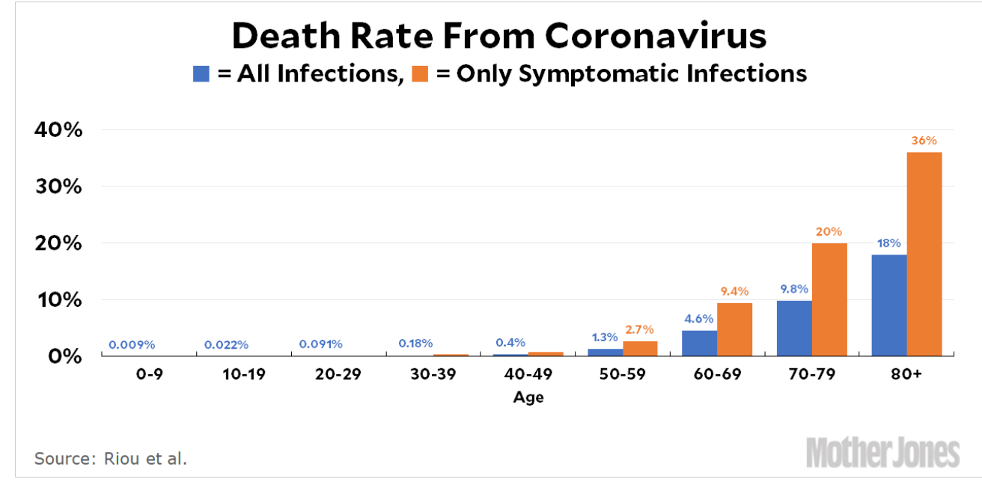
MOAR Coronavirus!
Death for Geezers!
Mortality for the Youngs very low…
It’s the flu for them—for you…
And an extra doubling—or is it 5%?—mortality for the asthmatic
And an extra doubling—or is it 5%?—mortality for the overweight

Slide 44
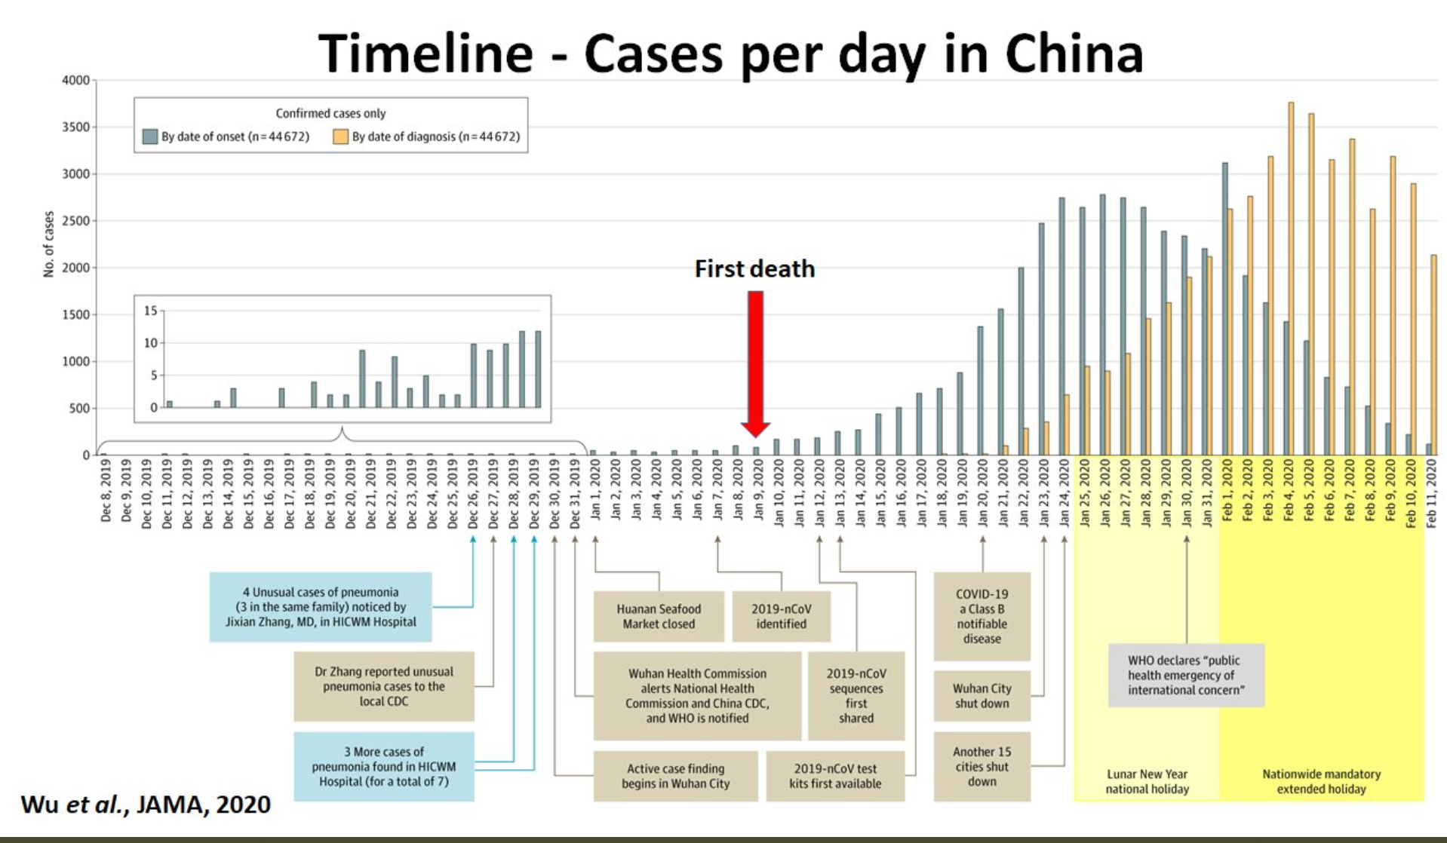
What We Think Happened in Wuhan
China beat it quickly & relatively easily!
We think
Shut down Wuhan when 200 cases per day
That seems to have been a good decision

Slide 45

The Goal
When Is It Appropriate to Move on This?
Immediate social distancing…
Self-isolate if you have a cough and a fever…
Hope that warmer temperatures will do to this what they did to SARS…
Otherwise, when do you want to start spreading out transmission. It seems that early is as good as later, so do it early…
I have no good intuition on why you want to move early
Plus your moving early will be wasted if you get reinfected
Plus the sparks you throw off making others’ lives more difficult

Slide 46
References
Financial Times (2020): Coronavirus Tracked: The Latest Figures as the Pandemic Spreads <https://www.ft.com/coronavirus-latest>
Nick Rowe (2020): Relative Supply Shocks, Unobtainium, Walras' Law, and the Coronavirus <https://worthwhile.typepad.com/worthwhile_canadian_initi/2020/03/relative-supply-shocks-unobtainium-walras-law-and-the-coronavirus.html>
Jim Stock (2020): Coronavirus Data Gaps and the Policy Response <https://drive.google.com/file/d/12MV466ZZy5xHir4xdPhoTrL1oO8CbZU-/view>

Slide 47
MOAR Coronavirus!
What I am watching:
Max Roser & Hannah Ritchie: Coronavirus Disease (COVID-19) <https://ourworldindata.org/coronavirus>…
Worldometer: Coronavirus Update (Live) <https://www.worldometers.info/coronavirus/>: ‘125,599 Cases and 4,605 Deaths from COVID-19 Virus Outbreak…
FT Coronavirus Tracker <https://www.ft.com/content/a26fbf7e-48f8-11ea-aeb3-955839e06441>
Josh Marshall’s COVID Twitter List <https://twitter.com/i/lists/1233998285779632128>
NEJM Group: Updates on the Covid-19 Pandemic <http://m.n.nejm.org/nl/jsp/m.jsp?c=%40kxNtXckRDOq8oG0jJvAXsIzN4mPECIPhltxoTSdTU9k%3D&cid=DM89089_NEJM_COVID-19_Newsletter&bid=173498255>: 'From the New England Journal of Medicine, NEJM Journal Watch, NEJM Catalyst, and other trusted sources...

Slide 48
Catch Our Breath…
Ask a couple of questions?
Make a couple of comments?
Any more readings to recommend?
<https://www.icloud.com/keynote/0YKEi7HeOrVGvKYtt9FEqH7nA>
<https://www.bradford-delong.com/2020/04/coronavirus.html>
github:<https://github.com/braddelong/public-files/blob/master/coronavirus.pptx>
https://github.com/braddelong/public-files/blob/master/coronavirus.pdf>
html File: <https://www.bradford-delong.com/2020/04/coronavirus.html>
Edit This File: <https://www.typepad.com/site/blogs/6a00e551f08003883400e551f080068834/post/6a00e551f080038834025d9b3bd66a200c/edit>
<https://delong.typepad.com/files/2020-04-01-coronavirus.pdf>

Slide 49
Coronavirus! (March 16)
With 31 deaths in the U.S. as of March 11, a 1% death rate, and up to 4 weeks between infection and death, that means that as of Feb 12 there were 3100 coronavirus cases in the United States.
With 87 deaths in the U.S. as of Mar 16, a 1% death rate, and up to 4 weeks between infection and death, that means that as of Feb 17 there were 8700 coronavirus cases in the United States
If it is doubling every seven days, then now about 150,000 people have and in the next week about 150,000 more people in the U.S. will catch coronavirus—which means 1/2200, currently 3500 of the 7.6 million inhabitants of San Francisco Bay. Touch a hard surface that any of those 3500 has touched in the last 48 hours, and the virus has a chance to jump to you…
These numbers could be five times too big. These numbers are probably not five times too small unless the thing is a lot less deadly, and there are a lot of asymptomatic cases…
What is wrong with this analysis?

Slide 50

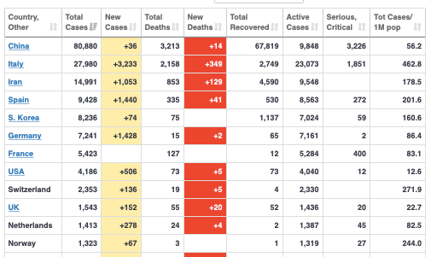
MOAR Coronavirus!
As of March 21: Things are not moving in the right direction:
What is the R0?
How can the R0 be changed?
How will the R0 change?
What is the asymptote share of the population?
What is the mortality rate?

Slide 51


MOAR Coronavirus!
As of March 10: Things are not moving in the right direction:
What is the R0?
How can the R0 be changed?
How will the R0 change?
What is the asymptote share of the population?
What is the mortality rate?

Slide 52
Notes

